Slide 1

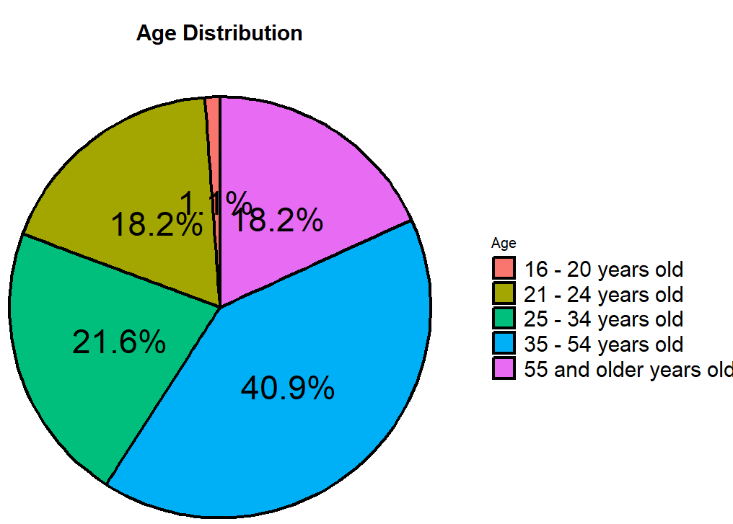
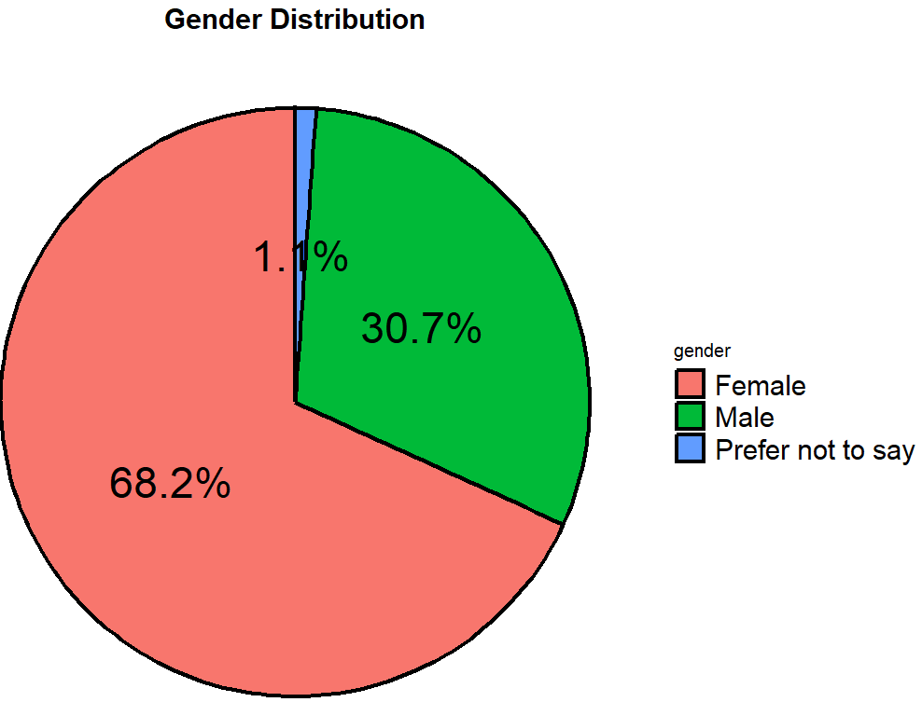
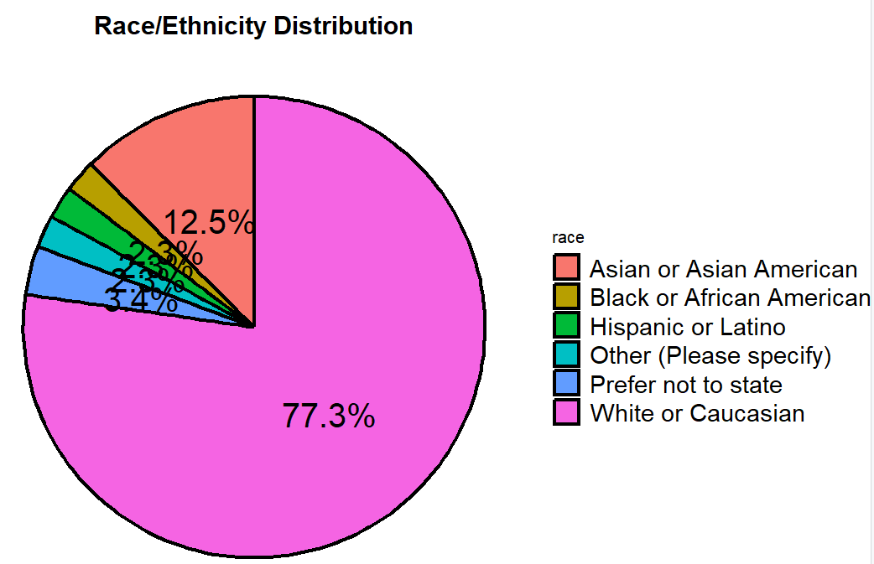

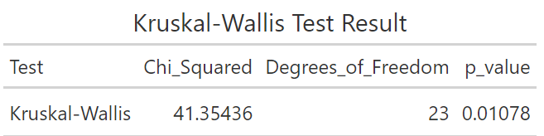
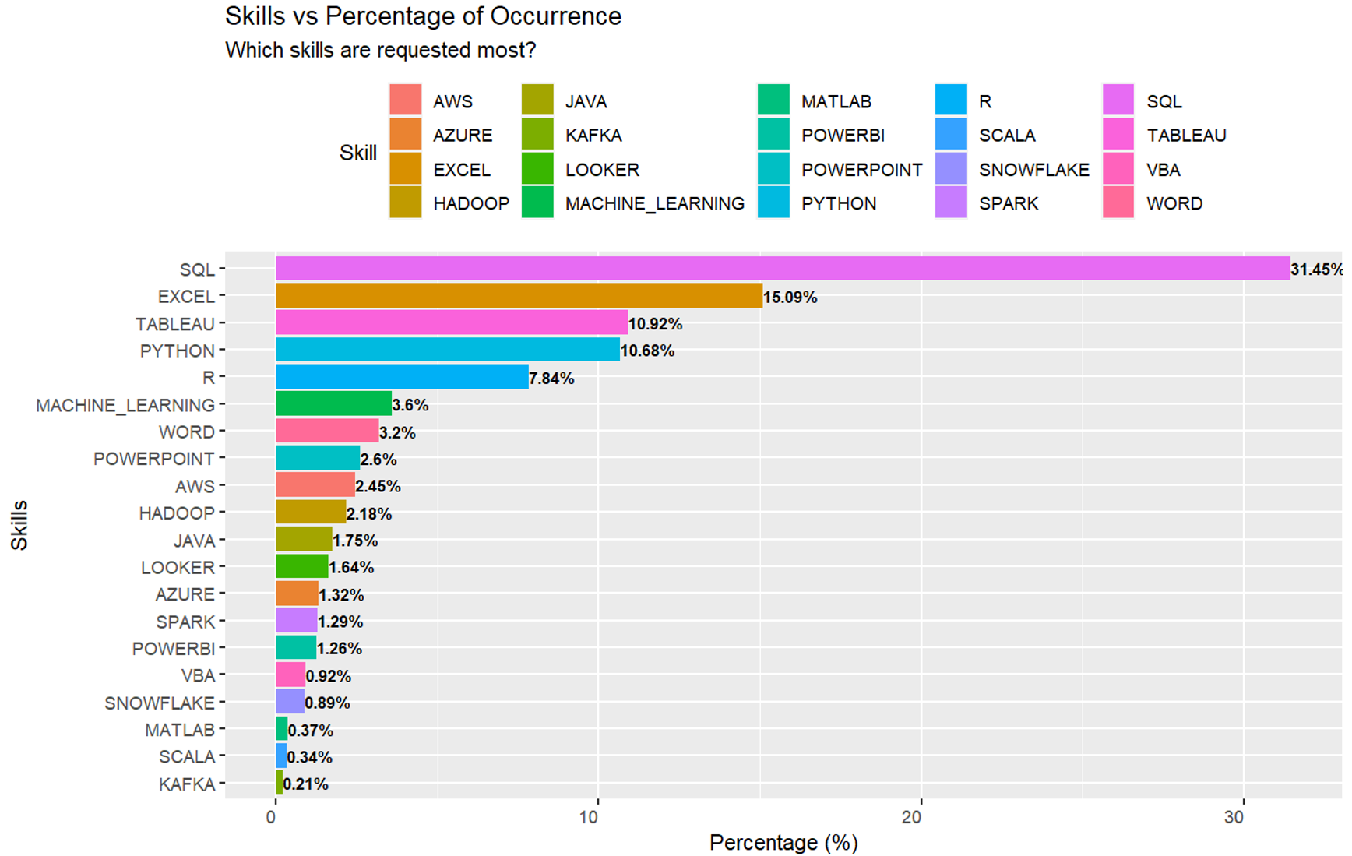
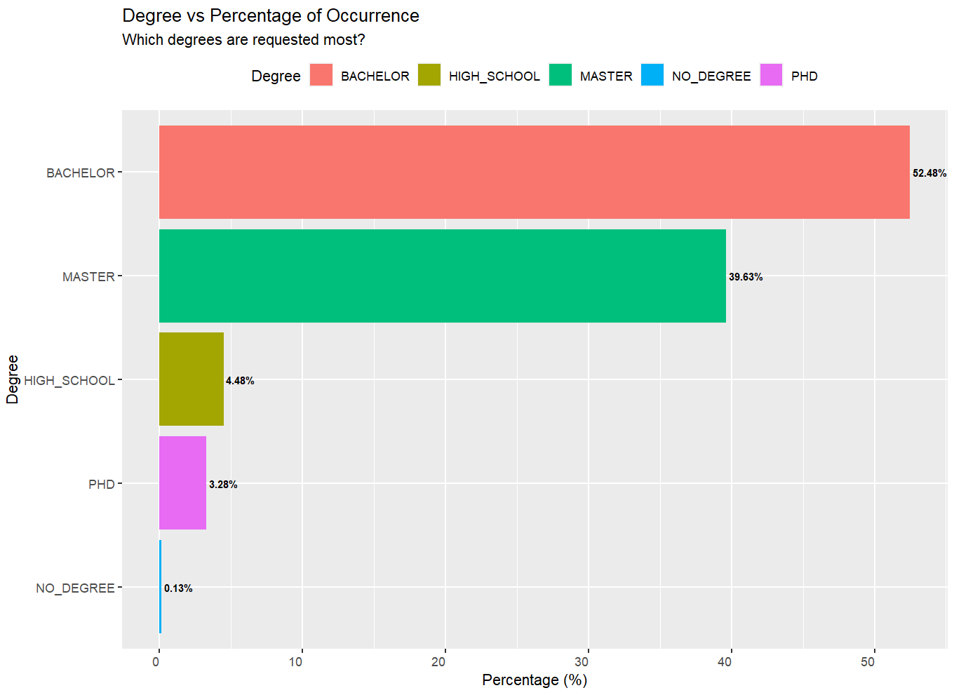
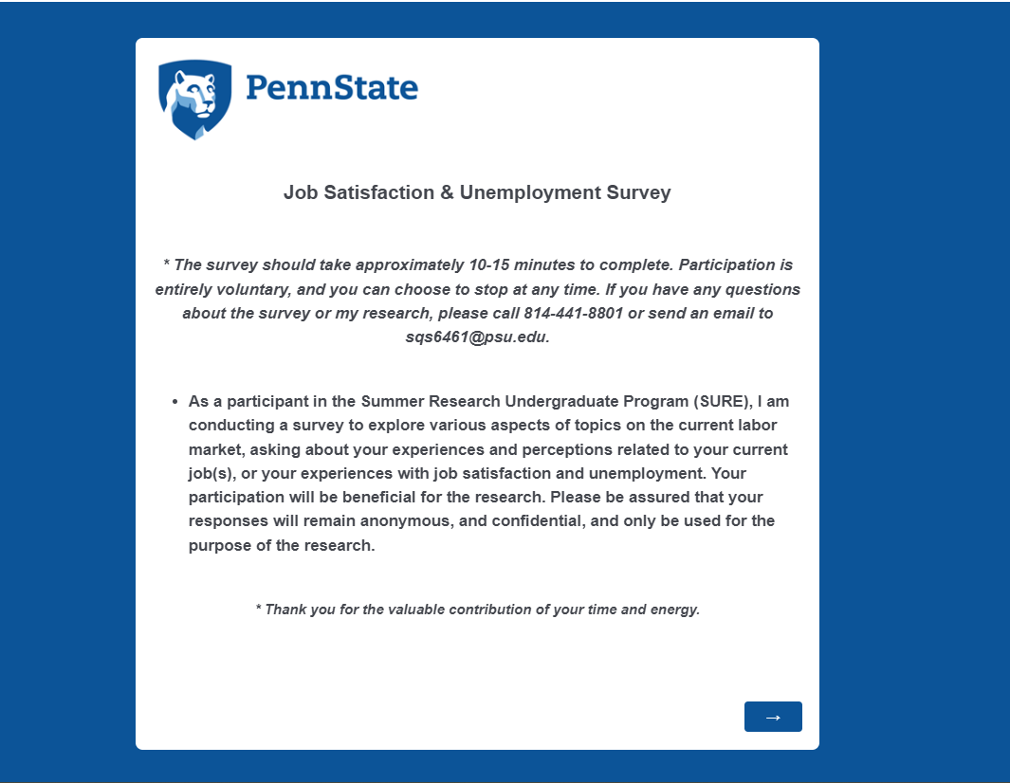

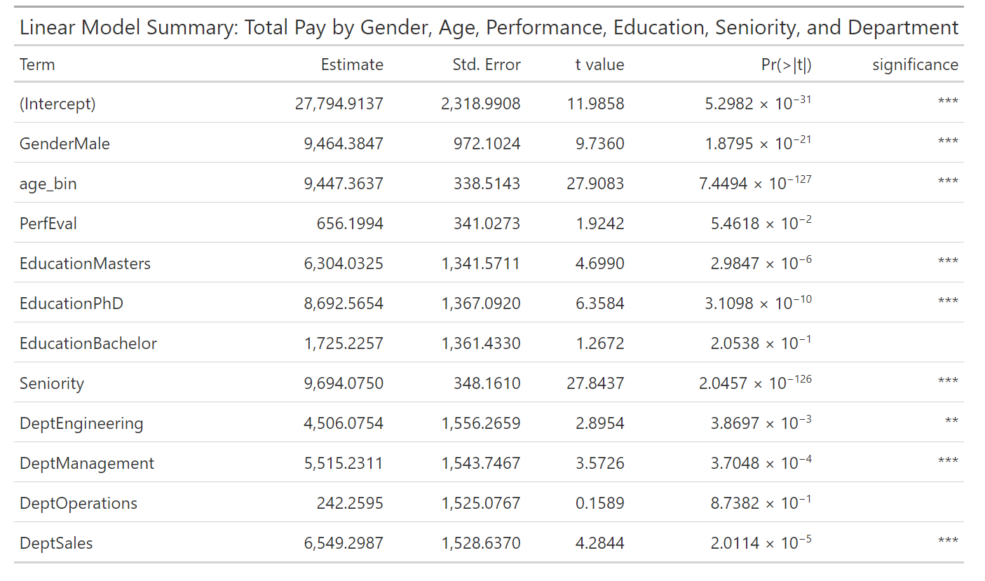
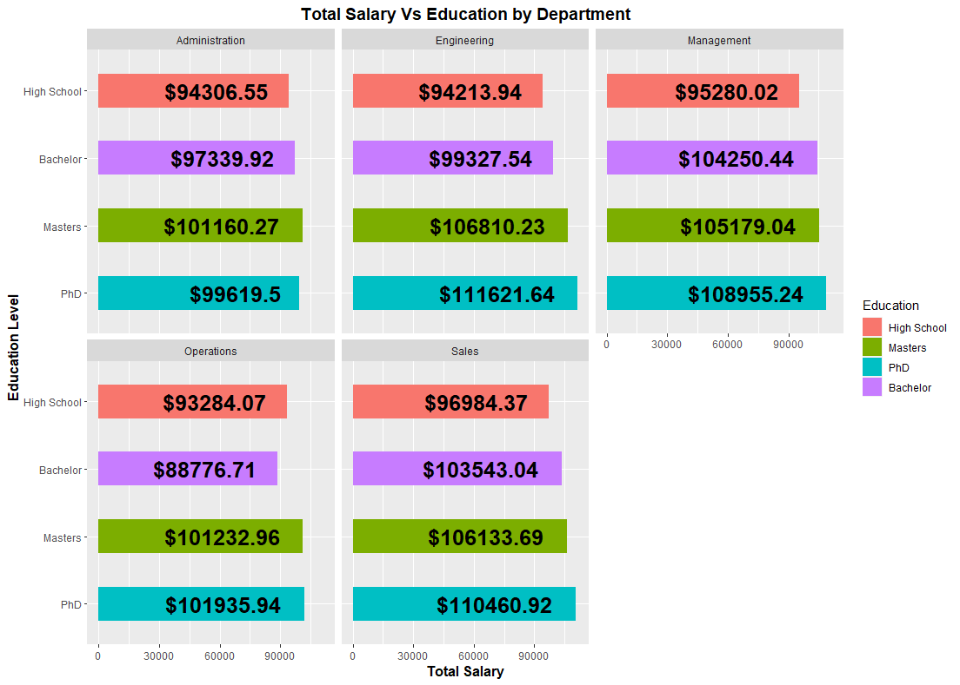
Dissecting Factors Influencing Salary, Gender Wage Disparity, and Job Satisfaction: A Study of the Data Analyst Job Market and the General U.S. Labor Market
Sejun Song and Prabhani Kuruppumullage Don (Ph.D)
Department of Statistics, Eberly College of Science, The Pennsylvania State University
Introduction
Analysis & Results
The U.S. labor market encompasses a wide array of industries, with data analysts playing a pivotal role.
Job satisfaction, salary, and gender wage disparity are significant factors influencing data analysts' job market experience¹.
These elements affect personal well-being, job performance, employee retention, and overall organizational productivity^{3.}
Comprehensive studies exploring these factors in the data analyst job market are limited.
Preliminary Survey Results Suggests:
  About 80% of respondents between ages 35-54 are satisfied with their jobs whereas 93% of the respondents between ages 25 – 34 are satisfied with their current jobs.
  About 82% of females and 86% of males are satisfied with their current jobs.
  About 45% of the respondents who are dissatisfied with their current jobs appear to have bachelor’s degrees.
Research Objectives & Data Sources
Job Satisfaction Survey
Identifying factors associated with job satisfaction and unemployment in U.S.
Glassdoor
Data from Kaggle on Data Analyst Job Market Suggests:
Studying the factors associated with gender-based salary disparity in the U.S. labor market.
  There is a significant difference in the average salaries among different sectors, as demonstrated by a p-value of 0.01078 in the Kruskal-Wallis test
  There is significant evidence to suggest a difference in average salaries between the Biotech & Pharmaceuticals and the both Finance and Restaurants, Bars & Food Services sectors based on post-hoc analysis using Dunn’s test
Kaggle
Understanding the patterns in data analytics job market: Job satisfaction, salaries, qualifications, etc.
Figure 1. Summary of Kruskal-Wallis Test Results comparing average salaries for data analyst roles across multiple sectors
Design and Construction of Job Satisfaction Survey
Survey Planning:
Literature Review on existing studies
New questionnaire on factors affecting job satisfaction and unemployment in the U.S
Study Design and Approval:
Built the survey on Penn State’s Qualtrics platform
Obtained IRB approval for the study
Figure 2. Bar Chart representation of the most in-demand skills for data analyst positions
Figure 3. Bar Chart illustrating the minimum degree requirements for data analyst positions as stated in various company job descriptions
Survey Distribution & Data Collection:
Survey launched and shared across multiple platforms
  Facebook, StudyFinder, Reddit, LinkedIn, etc
Total of 131 responses were collected
Data from Glassdoor on US Labor Market Suggests:
  On average, male data analysts tend to earn about $9,464 more than their female counterparts
  Data analysts holding a Masters or PhD degree generally earn more. Specifically, those with a Masters degree earn about $6,304 more on average, and those with a PhD earn around $8,692 more on average.
References & Acknowledgement
The data analyst Job Outlook in 2023: Job market research. 365 Data Science. (2023a, July 12). https://365datascience.com/career-advice/data-analyst-job-outlook/
U.S. Bureau of Labor Statistics. (2023, February 6). Operations research analysts : Occupational Outlook Handbook. U.S. Bureau of Labor Statistics. https://www.bls.gov/ooh/math/operations-research-analysts.htm
Dhamija, P., Gupta, S. and Bag, S. (2019), "Measuring of job satisfaction: the use of quality of work life factors", Benchmarking: An International Journal, Vol. 26 No. 3, pp. 871-892. https://doi.org/10.1108/BIJ-06-2018-0155
Employment / underemployment questionnaire - GPI Atlantic. (n.d.-a). http://gpiatlantic.org/pdf/communitygpi/communitypart2b.pdf
Cavusoglu, Behiye & Cek, Kemal & Eyupoglu, Serife. (2021). Modelling job satisfaction using a logistic regression model. AIP Conference Proceedings. 2325. 020047. 10.1063/5.0040383.
This research was funded by the Summer Undergraduate Research Program from the Eberly College of Science at the Pennsylvania State University.
Figure 4. Results of the Regression Model Exploring Total Pay by Adjusted Variables
Figure 5. Faceted Bar Charts of Salary Distribution by Education Level and Department

